Slide 1
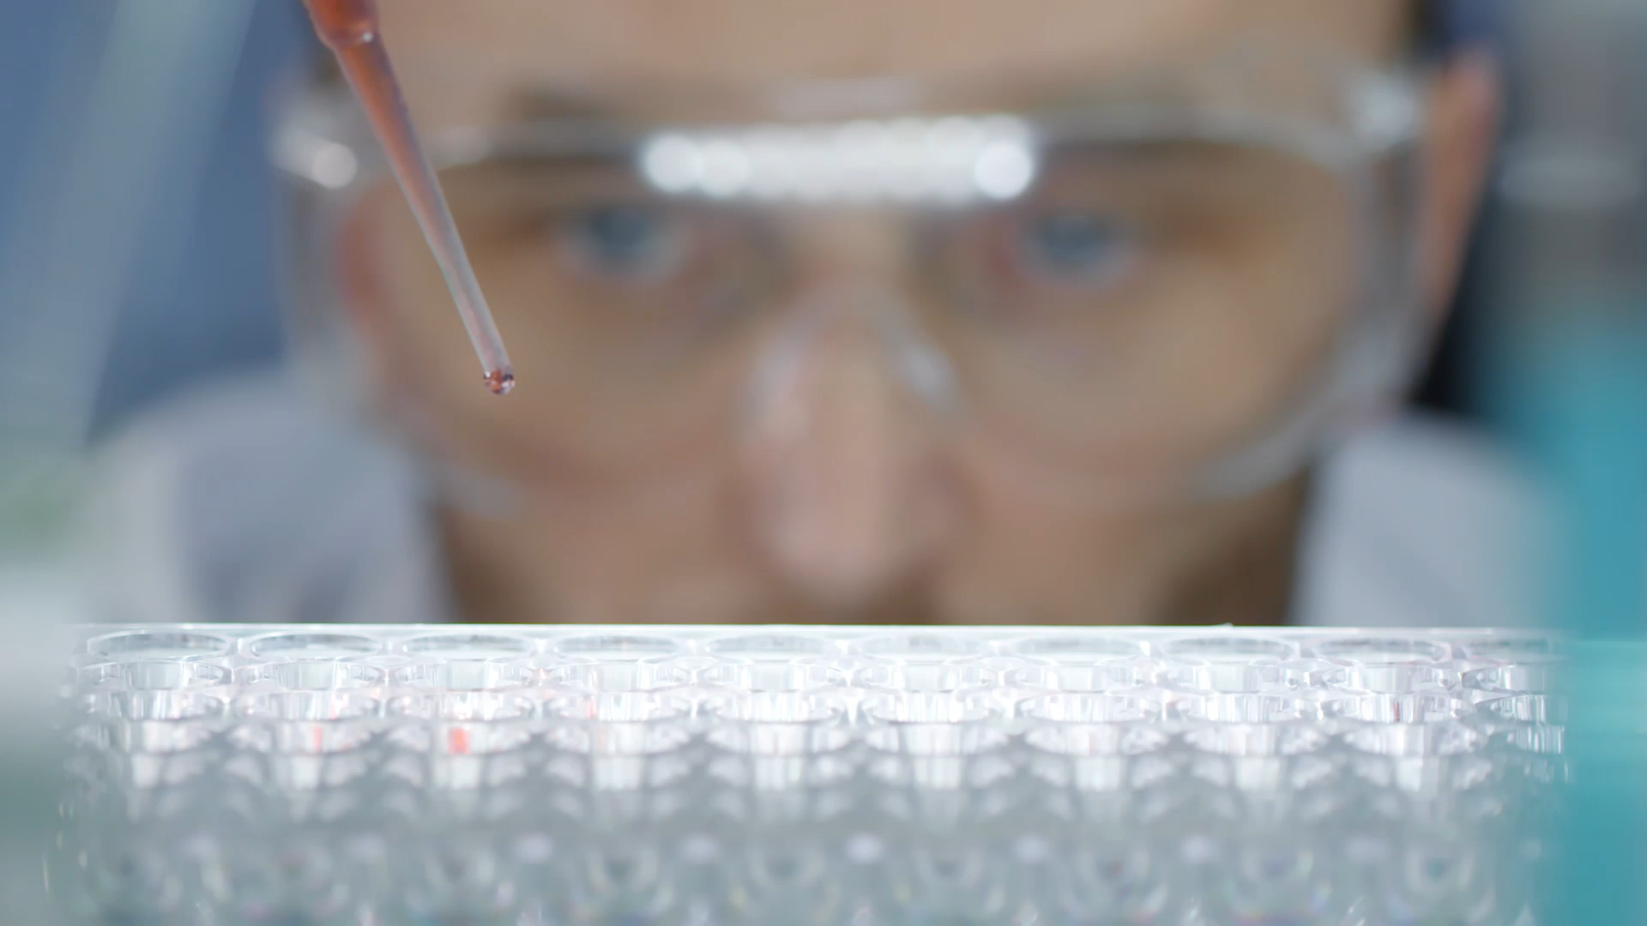
Citizen Science
Stormwater Monitoring for Bellingham Bay

Slide 2
Agenda
Introductions
Scope
BACKGROUND
Ideation
Roles and Reference Frames
Resources and Next Steps

Slide 3
Introductions
Name
Reason you said “Yes”
Best community participation experience and why?
What do you love about Bellingham?

Slide 4
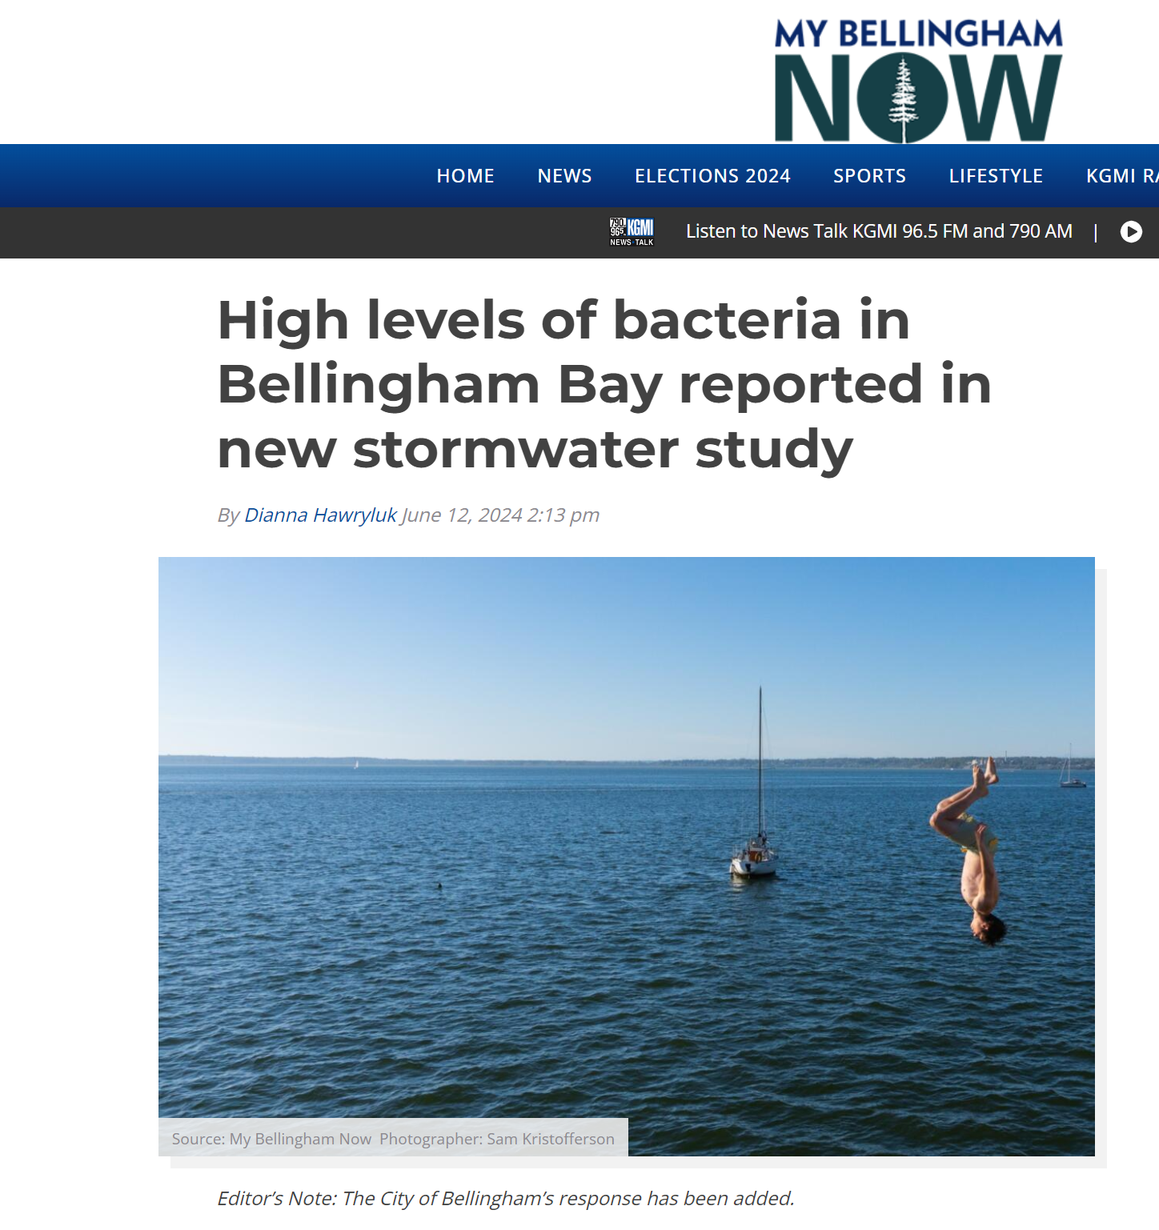
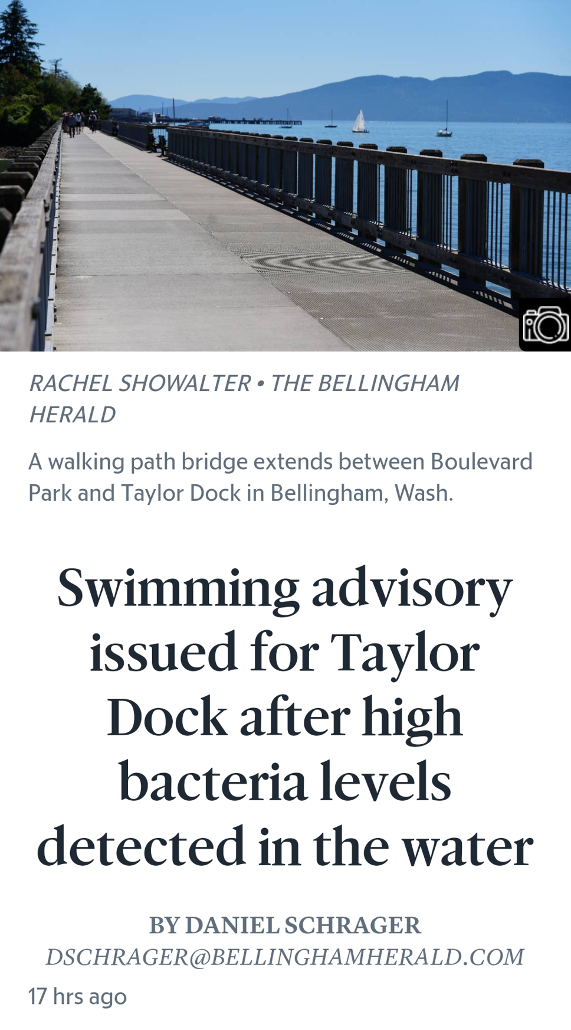
Scope

Slide 5
Scope
June 07, 2024 - by City of Bellingham Communications Team
Swimming advisory issued for southern end of Boulevard Park: With the warm weather arriving, we know that folks will be flocking to places to swim, and Boulevard Park and Taylor Dock are popular spots. Please avoid swimming in this area due to high levels of fecal coliform bacteria in the water that may cause illness upon contact. The Whatcom County Health Department issued a no-contact advisory for the southern end of Boulevard Park on May 31, 2024 when high bacteria results were found near Taylor Dock during an inspection.
August 02, 2024 - by City of Bellingham Communications Team
Responding to pollution reports: In late May, we received reports of elevated fecal coliform bacteria levels where stormwater enters Bellingham Bay. We conducted sampling, source tracing, infrastructure reviews, and permit reviews, but were unable to identify a specific source. This is often the case with bacteria pollution. Rainwater carries fecal coliform bacteria from yards, parks, trails, roads, and sidewalks into our waterways.
Called “nonpoint source pollution,” it often comes from many small sources, such as pet waste, wildlife droppings, manure, and yard debris. We all have a role to play when it comes to preventing pollution and protecting water quality, like properly disposing of pet waste at home and on trails. On our website, you can learn about how we address stormwater pollution work and ways you can help.

Slide 6

Scope
Re Sources Published a three-year report on the status of the pollution of Bellingham Bay.
The City of Bellingham stormwater permit from Washington Department of Ecology stipulates response to pollution exceedances.
No clear action plan to validate, improve monitoring, and resolve pollution sources
Use the scientific method and quality framework to determine if the methods are sound and the response is efficient and effective

Slide 7
Scope
Partner with non-profits and government (city, state) to learn about the best practices for stormwater pollution monitoring.
Re Sources (https://www.re-sources.org/initiative/polluted-runoff-stormwater/ )
Salish Sea Stormwater Monitoring (https://stormwater-salishsea.org/ )
City of Bellingham (https://cob.org/services/environment/stormwater )
Washington Department of Ecology (https://ecology.wa.gov/water-shorelines/water-quality/saltwater/beach-program )
United States Enivironmental Protection Agency (Clean Water Act)
Use the scientific method and quality frameworks to improve the methods and the responses

Slide 8
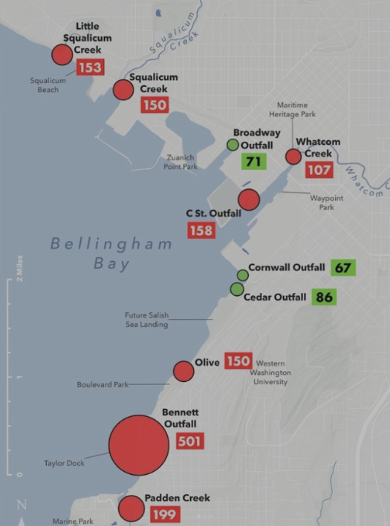
Background
https://www.instagram.com/p/C7xP4-8sD8-/?img_index=1e?
Re Sources performs monthly sampling of at 6 stormwater outfalls and 4 urban creeks by volunteers
What do numbers indicate?
What does green vs. red threshold?
https://maps.waterreporter.org/YWYyWhplWrDl/
June 3rd 2024

Slide 9

Process
What parameters are collected?
Data collection overview

Slide 10
Parameters
Name | Description | Threshold (Outfalls) | Threshold (Creeks)
Arrival Time | Time (Date HH:MM) | NA | NA
Air Temp (deg C) | Air Temperature | NA
Flow (N, M, T, H) | Water flow…Flow Rate: Trickle, Normal, Moderate, High | 1 = normal, 2= M+ during dry weather | NA
Color (0-3) | Color | Any non-natural phenom (≥ 1) | Any non-natural phenom (≥ 1)
Odor (0-3) | Smell | Any non-natural phenom (≥ 1) | Any non-natural phenom (≥ 1)
Visual (0-3) | Visual artifacts…sheen, floaters, foam | Any non-natural phenom (≥ 1) | Any non-natural phenom (≥ 1)
Water Temp (deg C) | Water temperature | 1 < ambient air T; 2 > ambient air T | > 16 C (1<= 16; 2 > 16)
DO (mg/L) | Dissolved Oxygen | > 6 mg/L | >8.0 mg/L
SPC (uS/cm) | Specific Conductance for dissolved minerals | > 500 uS/cm | None but note if > 500 uS/cm
Salinity (ppt) | Salinity | Note: >0.5 = likely marine intrusion | Note: >0.5 = likely marine intrusion
pH | Acidity | < 5 or > 9 | < 6.5 or > 8.5
Turbidity (ntu) | Cloudiness | > 50 ntu | Specific to stream
E. Coli (cfu / 100 ml) | Fecal Bacteria | > 300 cfu/100 mL | > 320 cfu/100 ml
Entero (cfu / 100 ml) |  | > 500 cfu/100ml | > 110 cfu/100ml

Slide 11
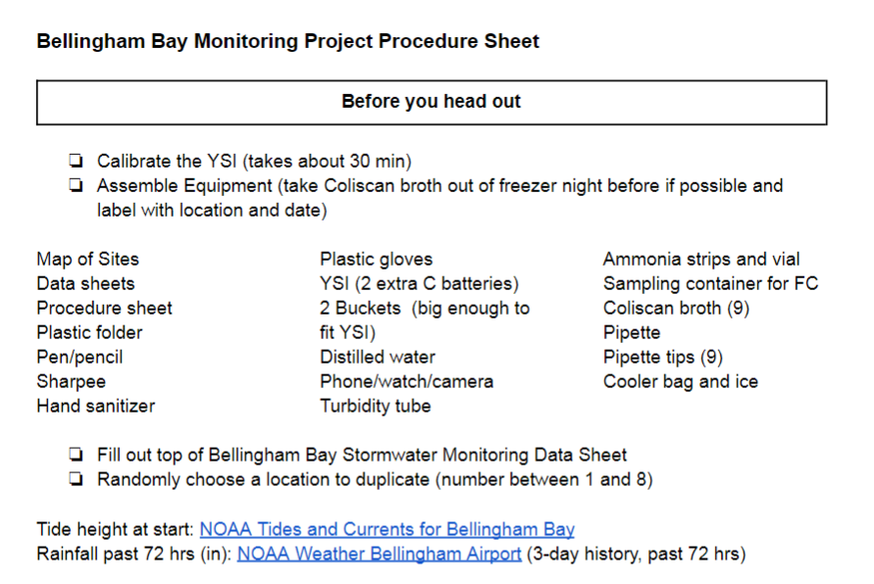
Process

Slide 12
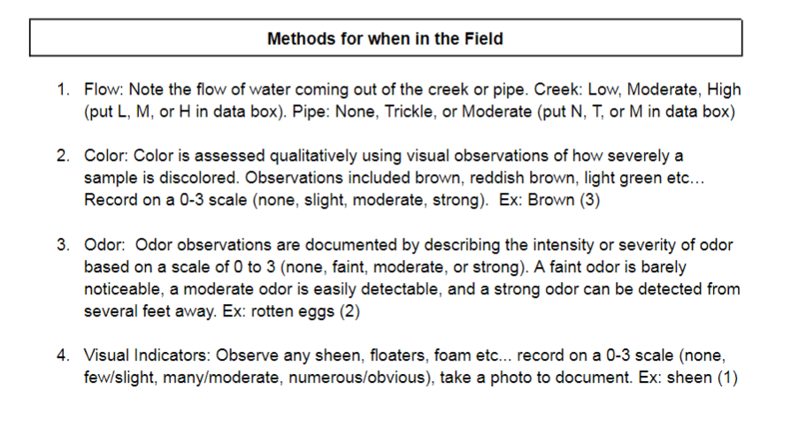
Process

Slide 13
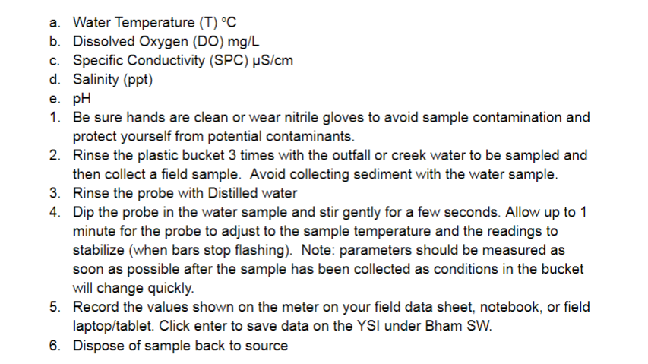
Process

Slide 14
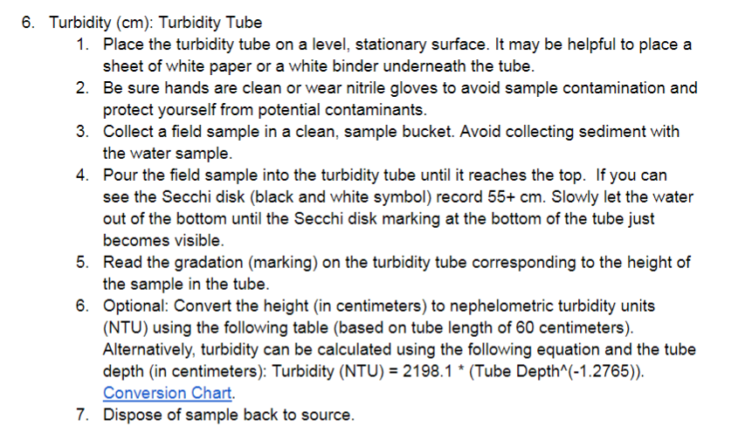
Process

Slide 15
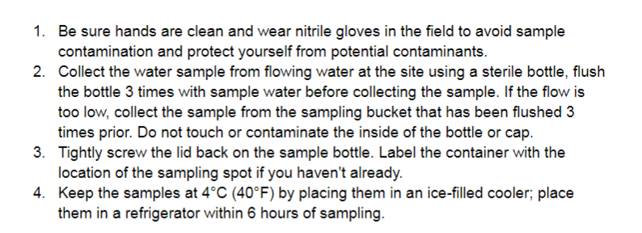
Process

Slide 16
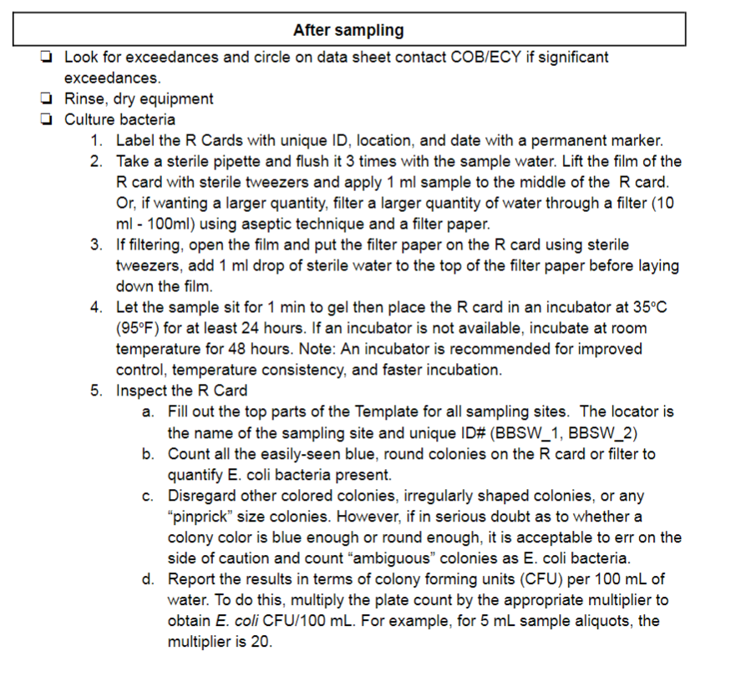
Process

Slide 17
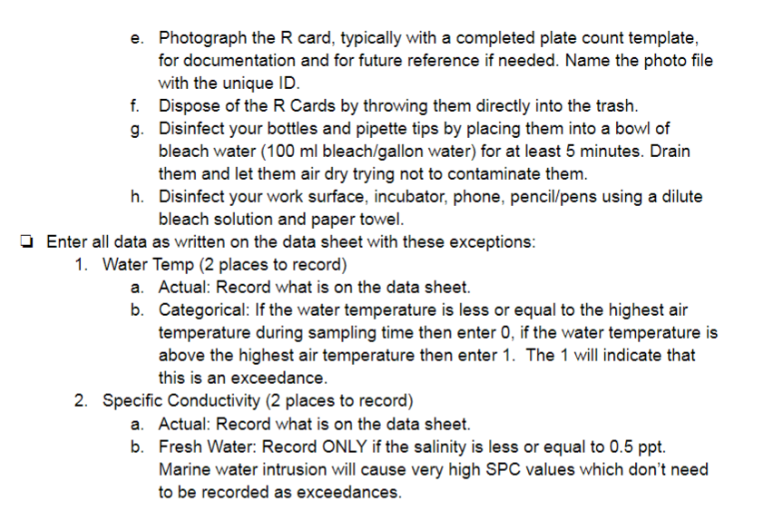
Process

Slide 18
Mitigation Examples
Show photos of Whatcom Creek fencing
Show alleyway drains

Slide 19
Next Steps
Collaboration Tools
Data analysis
Report synthesis
Research best practices around the world
Q&A with Re: Sources

